Slide 1

The Detroit Project
by
Nikhil Hodarkar
July 29, 2020
NYC

Slide 2
The Business Problem
Detroit, a once large and vibrant manufacturing center, has been in economic decline for several decades and in particular since the 2008 financial crisis.
People and businesses have been leaving the city for many years, dropping the population from a high of 1.8 million to a current level around 670,000 (source: Wikipedia)
Although community leaders have made tremendous efforts to grow the city, much more work still needs to be done.
Project Goal
Use Foursquare API data to identify Detroit and New York City neighborhoods that are “similar”.
“Similarity” will be determined through a K-means clustering algorithm on the types of businesses in the neighborhoods, according to Foursquare API data.
Targe Audience / Interested Parties / Stakeholders
The target audience for this project are the community leaders of Detroit who are actively seeking to attract new businesses to the city.
Identifying “similar” neighborhoods in NYC may allow them to focus on attracting business from those neighborhoods to move to the “similar” neighborhoods in Detroit.
NYC
Introduction
Data
Methodology
Results & Analysis
Discussion
Conclusion

Slide 3
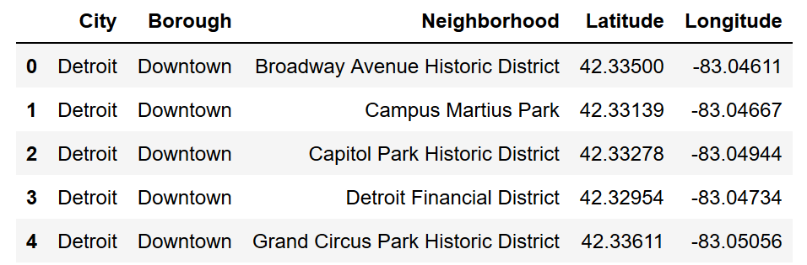
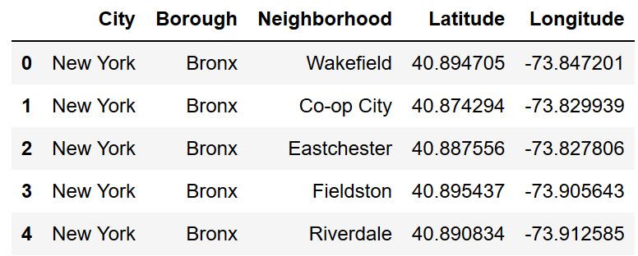
Data Used:
Geolocation data for Detroit and New York City neighborhoods (latitude/longitude)
Foursquare API data showing specific business within the neighborhoods and their business type
Demographic data on the neighborhoods (e.g., median age, median income, median house value)
Geolocation Data:
Neighborhood names and latitude/longitude pairs for Detroit were scraped from https://en.wikipedia.org/wiki/List_of_neighborhoods_in_Detroit, and the corresponding information for New York was obtained from https://geo.nyu.edu/catalog/nyu_2451_34572.
Detroit data frame head
New York data frame head
NYC
Introduction
Data
Methodology
Results & Analysis
Discussion
Conclusion

Slide 4
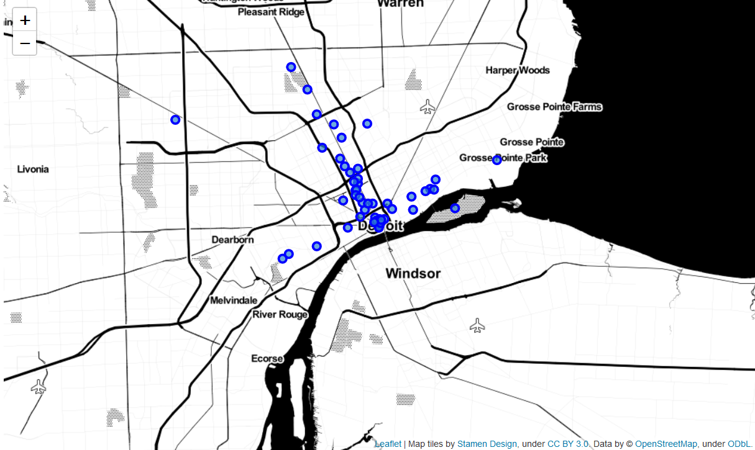
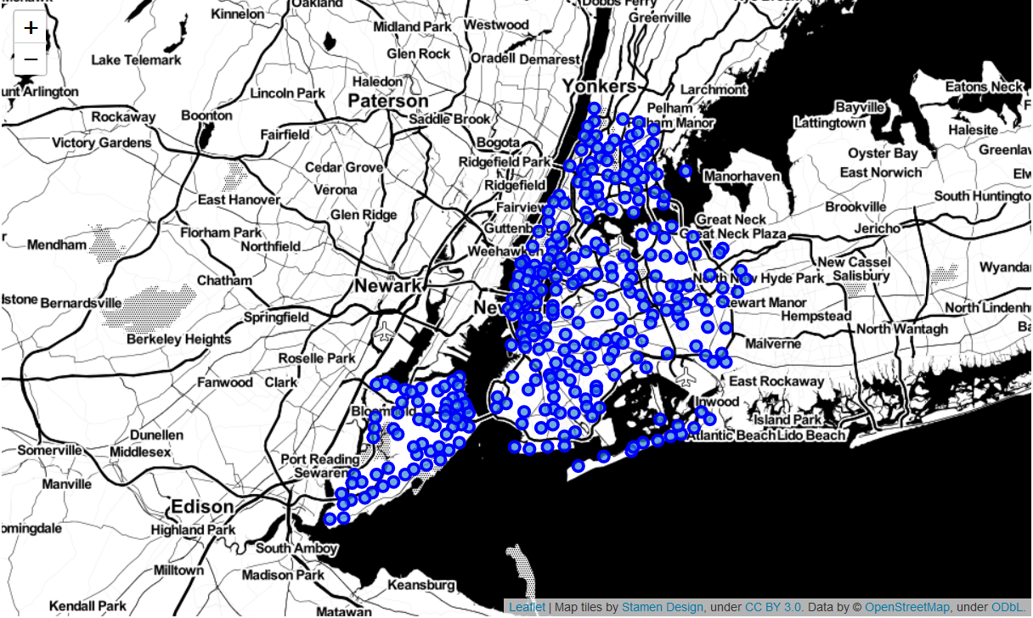
Neighborhoods Analyzed:
In total, this project analyzed 49 neighborhoods in Detroit and 306 neighborhoods in New York City.
Detroit Neighborhood Map
New York Neighborhood Map
NYC
Introduction
Data
Methodology
Results & Analysis
Discussion
Conclusion

Slide 5
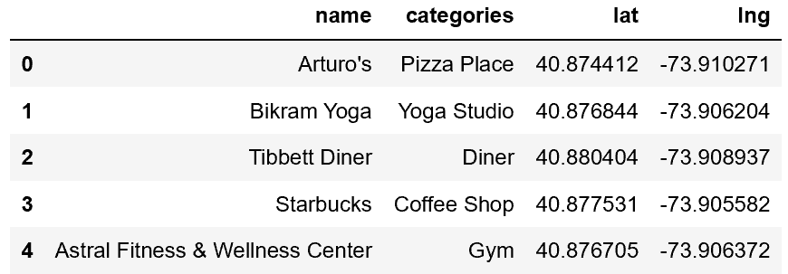
Foursquare API Data:
Using the geolocation data for the neighborhoods, the Foursquare API was queried to provide information on venues within 500 meters of latitude and longitude coordinates of the neighborhoods, with a limit of 100 venues per neighborhood. (Available at https://foursquare.com/)
The data that used for clustering analysis was the category of each venue.
As an example, the following are a few of the venues returned for the Marble Hill neighborhood in New York:
NYC
Introduction
Data
Methodology
Results & Analysis
Discussion
Conclusion

Slide 6
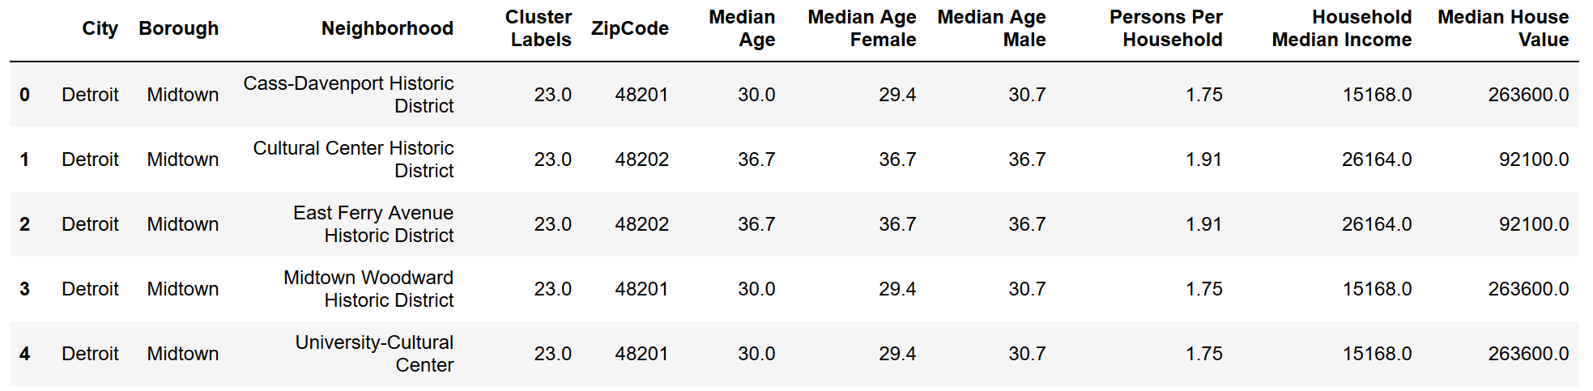
Demographic Data:
Demographic data on the selected cluster neighborhoods was obtained via zip codes.
First, openstreetmap.org’s Nominatim API was used to convert latitude and longitude data into zip code data. Once each of the selected neighborhoods had a zip code associated with it, the zip code information was used to obtain census-type data from CDX Technologies at https://www.cdxtech.com/tools/demographicdata/.
The returned data file includes dozens of demographic data fields for each zip code, but only the following attributes were analyzed: ‘Median Age’, ‘Median Age Female’, ‘Median Age Male’, ‘Persons Per Households’, ‘Household Median Income’ and ‘Median House Value’.
The following is an example of what the demographic data looks like:
NYC
Introduction
Data
Methodology
Results & Analysis
Discussion
Conclusion

Slide 7
Methodology Overview:
This project and its analysis entailed:
collecting latitude and longitude data on neighborhoods in both Detroit and New York City,
using that geographical data to collect information through the Foursquare API on business types in those neighborhoods, and
using a K-means clustering algorithm to cluster the neighborhoods based on their respective business types.
K-means clustering is an algorithm that takes a set of data points and a specified number of clusters and partitions those data points into that number of clusters. The algorithm attempts to minimize the squared “distance” from the cluster data points to the center of the cluster.
In this case, the “distance” is along the Foursquare “Venue Category” space, which has 436 dimensions. The algorithm doesn’t guarantee an optimal solution, but it should yield clusters where the neighborhoods have a substantially similar “Venue Category” nature.
(K-means algorithm description from https://en.wikipedia.org/wiki/K-means_clustering)
After clusters containing both Detroit and New York neighborhoods were identified, additional demographic information was obtained on those neighborhoods using zip code data.
NYC
Introduction
Data
Methodology
Results & Analysis
Discussion
Conclusion

Slide 8
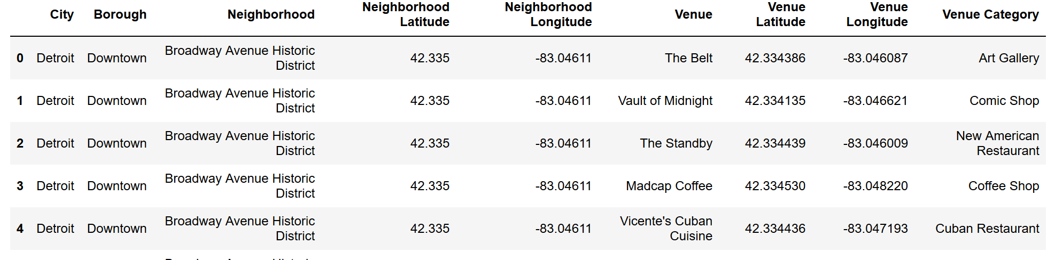
Step 1 – Get Foursquare API Venue Information for each Neighborhood:
The Foursquare API returned venues within 500 meters of the listed coordinates, up to a limit of 100 venues per neighborhood.
In total, 11,841 venues were returned.
Below is a snapshot of the data:
NYC
Introduction
Data
Methodology
Results & Analysis
Discussion
Conclusion

Slide 9
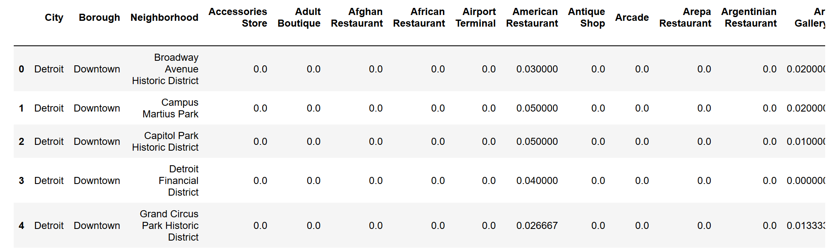
Step 2 – Create Dummy Variable Data Frame for All Unique Venue Types:
In the second step, each unique “Venue Category” value was turned into a column in a data frame that is essentially a matrix of dummy variables for each venue/neighborhood combination.
Next, the data frame is grouped by neighborhood, with each venue category having a value equal to the mean of all the dummy variables in that category for that neighborhood.
A snapshot of the data frame looks like this:
NYC
Introduction
Data
Methodology
Results & Analysis
Discussion
Conclusion

Slide 10
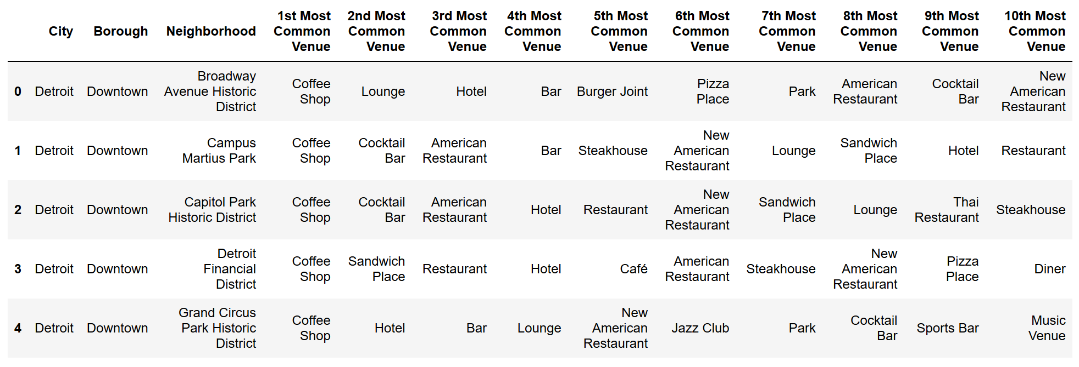
Step 3 – Identify Top 10 Venues of Each Neighborhood:
Before doing the clustering analysis, we can use the matrix of venue category means to identify the top 10 venues for each neighborhood, based on frequency of venue type. This information will be used in the “Results and Analysis” section.
The resulting data frame head looks like this:
NYC
Introduction
Data
Methodology
Results & Analysis
Discussion
Conclusion

Slide 11
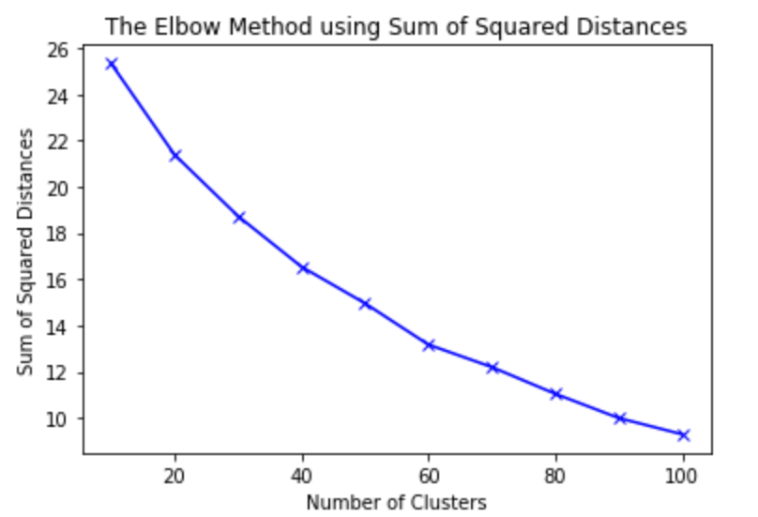
Step 4 – Use Elbow Method to Identify an Acceptable Number of Clusters:
The elbow method was used to determine the optimal number of clusters, however, a true optimal number was not identified.
The sum of squared distances between the data points and the cluster centers (the “inertia”) continued to decrease in an approximately linear fashion without a clear inflection point.
The goal is to get meaningful clusters with related data points. Accordingly, the number of clusters was set to 100, which yielded 3 moderately sized clusters that each contained both Detroit and New York neighborhoods.
Elbow method information from https://www.geeksforgeeks.org/elbow-method-for-optimal-value-of-k-in-kmeans/
NYC
Introduction
Data
Methodology
Results & Analysis
Discussion
Conclusion

Slide 12
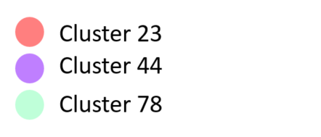
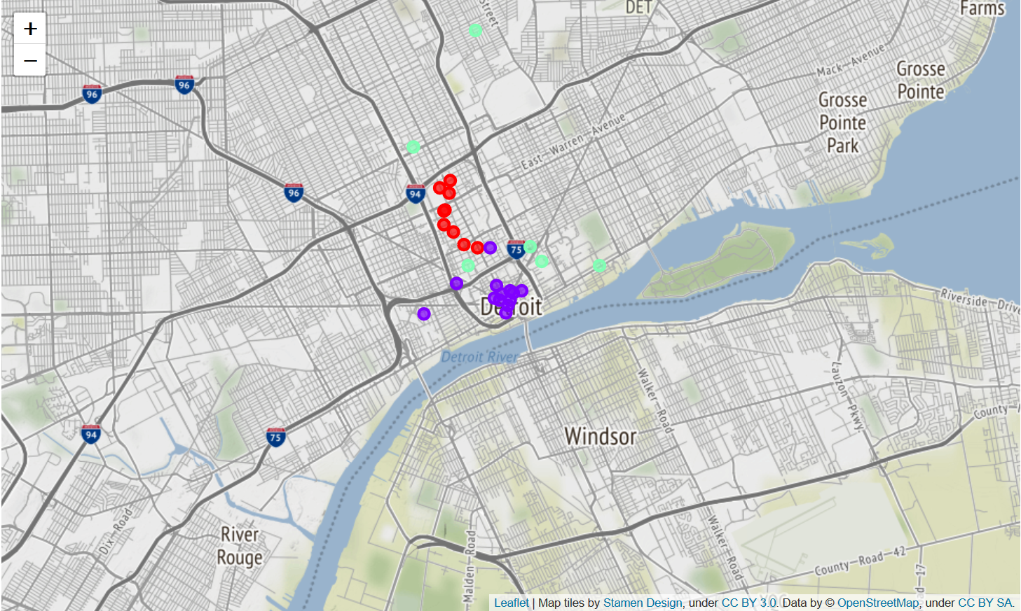
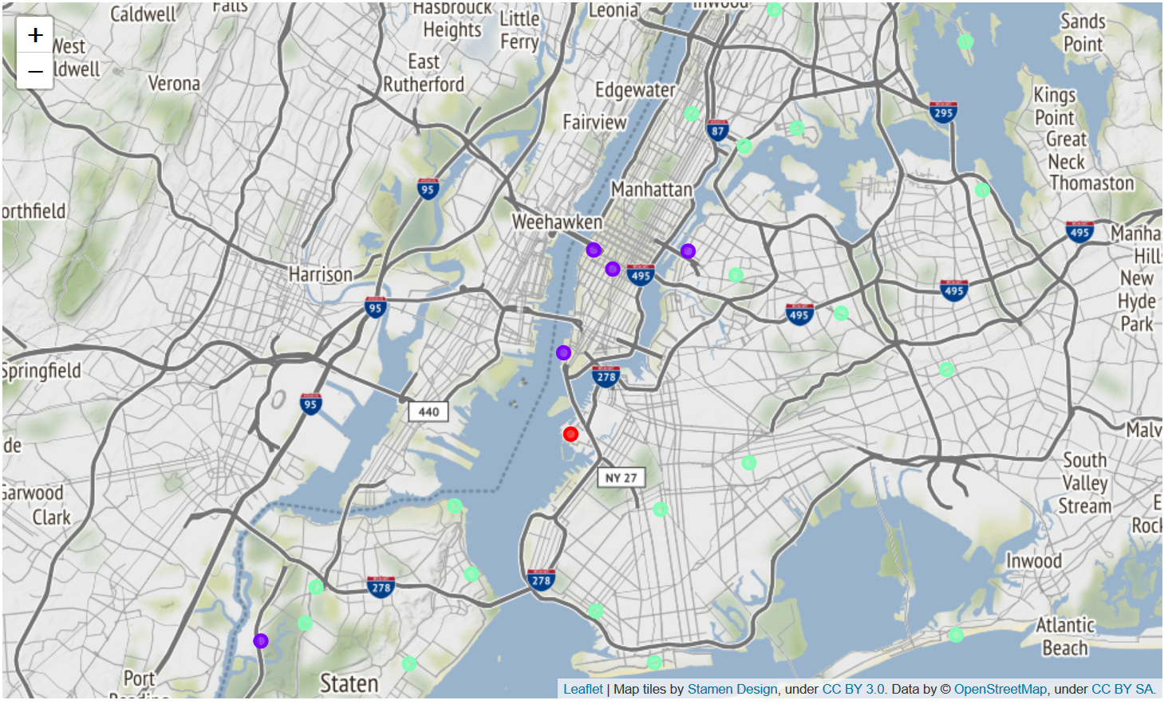
Results & Analysis:
The results of the K-means cluster analysis yielded 3 clusters that contained both Detroit and New York neighborhoods. These are clusters numbered 23, 44 and 78, which are the focus of this report.
Detroit Neighborhoods
New York Neighborhoods
NYC
Introduction
Data
Methodology
Results & Analysis
Discussion
Conclusion

Slide 13
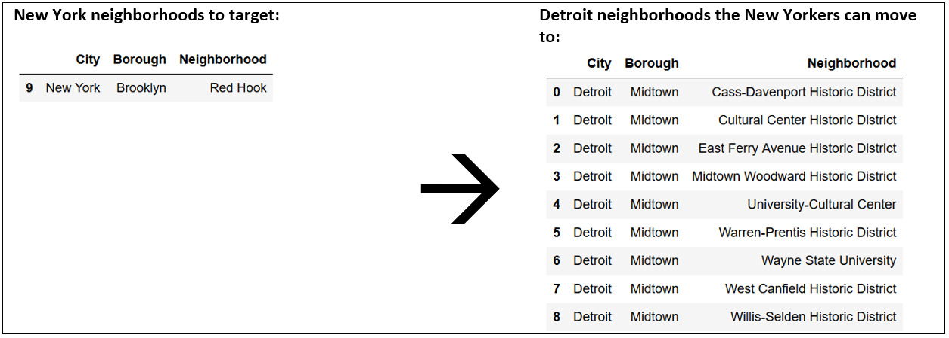
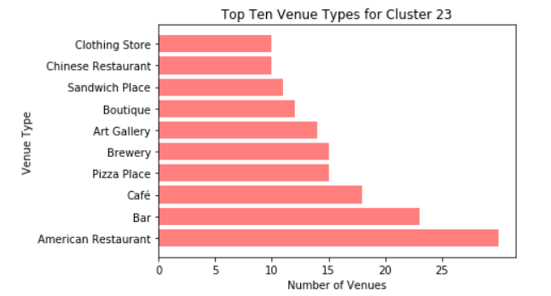
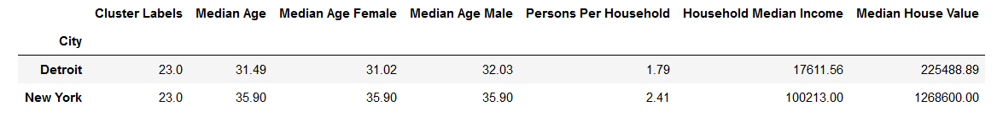
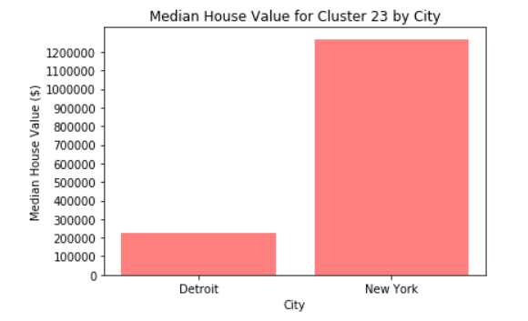
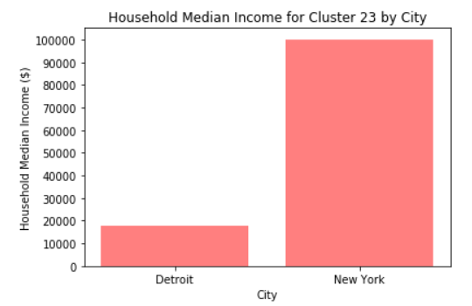
Cluster 23 – Summary Data
NYC
Introduction
Data
Methodology
Results & Analysis
Discussion
Conclusion

Slide 14
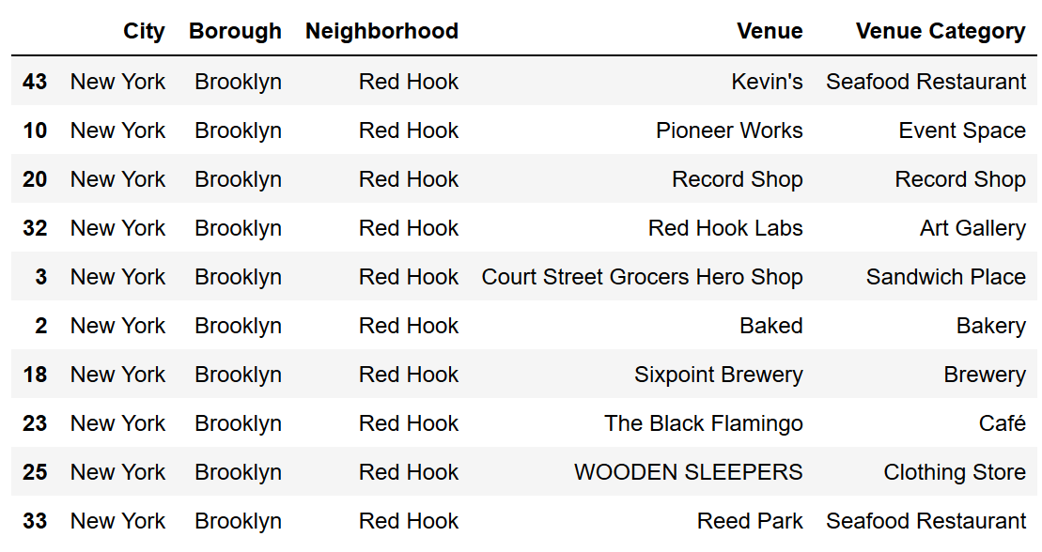
Cluster 23 – A “Residential” / “Social” Cluster
Cluster Type: Residential w/ Social Scene
Cluster 23 includes many eating places, bars, clothing stores and art galleries. This looks like the profile of a residential area with an active social scene.
Demographics takeaway for New Yorkers who move:
lower cost of living for themselves and a lower cost of labor for their businesses.
Example business targets:
NYC
Introduction
Data
Methodology
Results & Analysis
Discussion
Conclusion

Slide 15
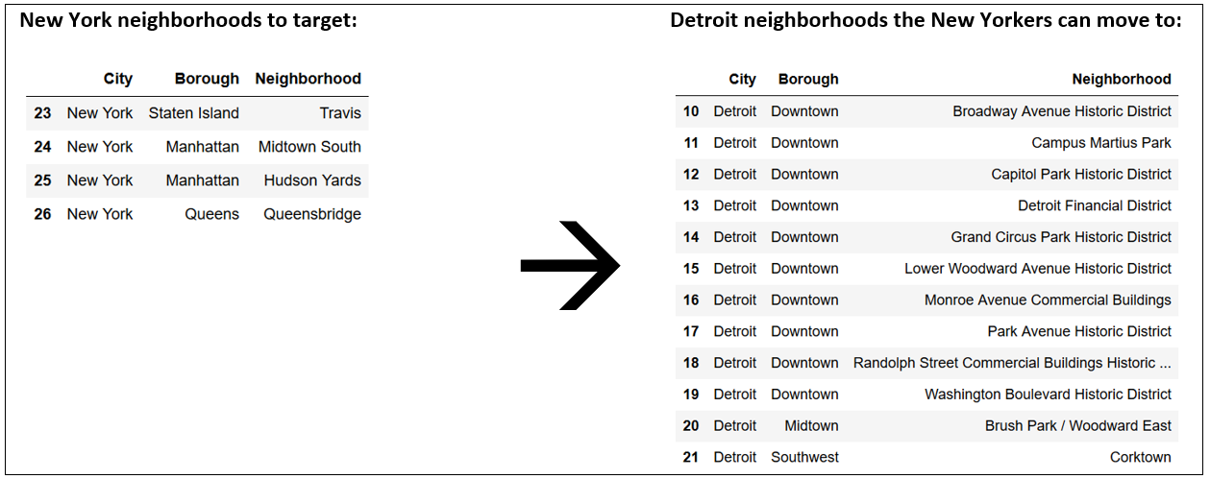
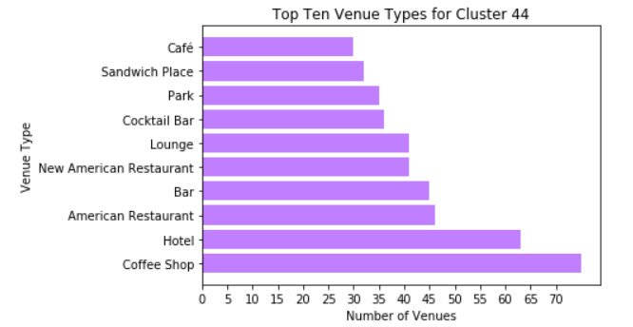
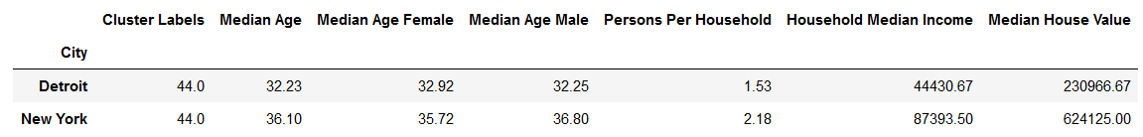
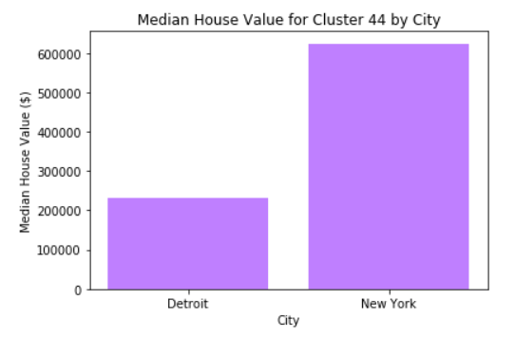
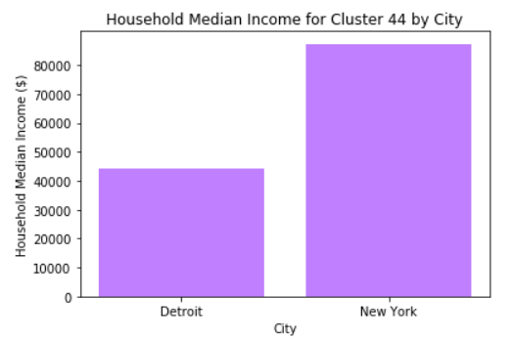
Cluster 44 – Summary Data
NYC
Introduction
Data
Methodology
Results & Analysis
Discussion
Conclusion

Slide 16
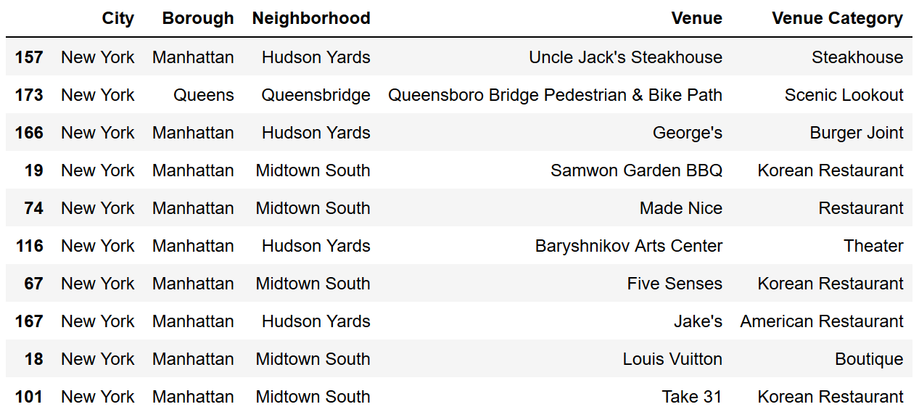
Cluster 44 – A “Night Out” Cluster
Cluster Type: “Night Out” type of neighborhoods
Many of the establishments are bars and restaurants, with hotels and parks as well. These are places people may go for recreation on a weekend or a night out.
Demographics takeaway for New Yorkers who move:
lower cost of living, lower cost of labor and less percentage of income spent on housing.
Example business targets:
NYC
Introduction
Data
Methodology
Results & Analysis
Discussion
Conclusion

Slide 17
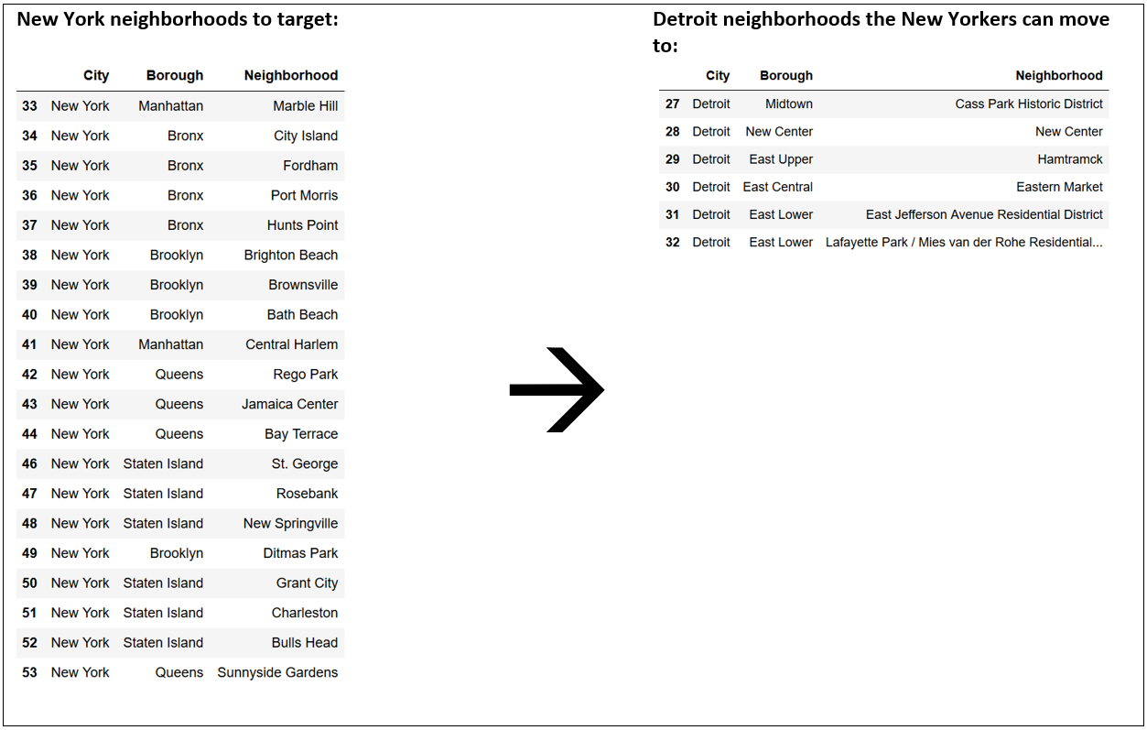
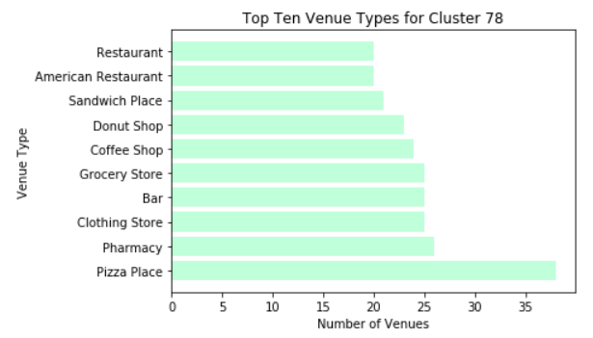
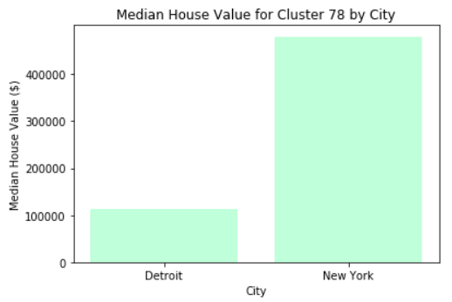
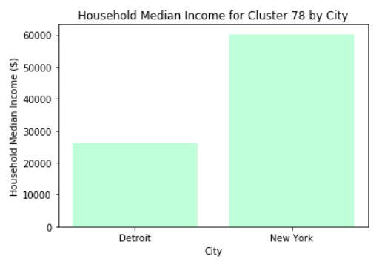
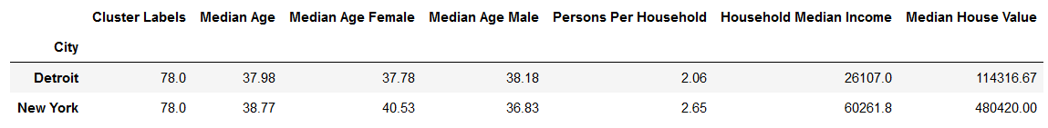
Cluster 78 – Summary Data
NYC
Introduction
Data
Methodology
Results & Analysis
Discussion
Conclusion

Slide 18
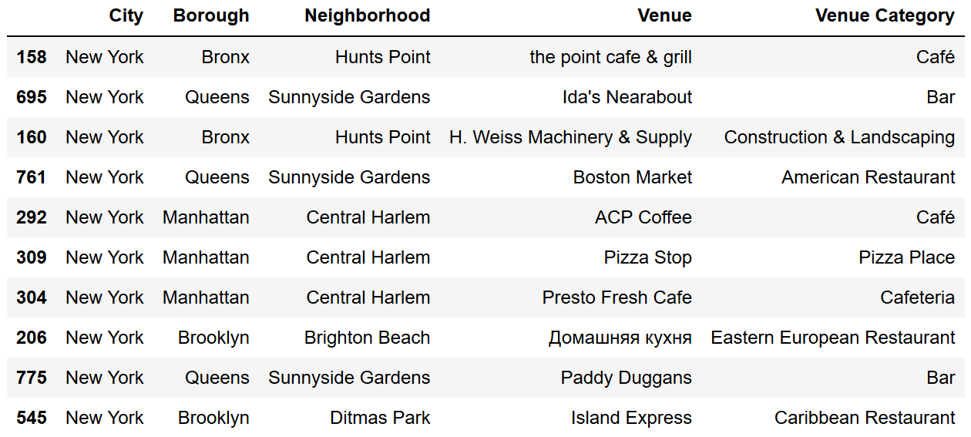
Cluster 78 – A “Residential” Cluster
Cluster Type: Residential
Cluster 23 includes a variety of quick-stop eating places, as well as pharmacies, clothing stores and grocery stores.
Demographics takeaway for New Yorkers who move:
lower cost of living, lower cost of labor and less percentage of income spent on housing.
Example business targets:
NYC
Introduction
Data
Methodology
Results & Analysis
Discussion
Conclusion

Slide 19
DISCUSSION
The goal of this project was to identify similar neighborhoods between Detroit and New York City, and three clusters were identified containing both Detroit and New York neighborhoods.
Cluster 23 included neighborhoods that were residential but with many venues for social activities.
Cluster 44 was characterized by venues a person might go to on a night out or on a weekend.
Cluster 78 appeared to be populated by purely urban residential neighborhoods.
The demographics between the New York neighborhoods and their Detroit counterparts, showed that New York was slightly older, with much higher levels of income and house values.
In a broad sense, this could be translated into Detroit having a lower cost of living and cost of labor.
Many New Yorkers may be turned off by Detroit’s lower numbers, but some percentage of them may be attracted to them.
NYC
Introduction
Data
Methodology
Results & Analysis
Discussion
Conclusion

Slide 20
DISCUSSION (Cont.)
This project has identified 25 New York City neighborhoods that community leaders in Detroit can target for attracting new businesses to the city of Detroit.
Project limitations:
Heavy reliance on Foursquare API data to do the clustering, which limits business data to those places frequented by Foursquare users. In a broader project, a more robust business dataset would be better, perhaps incorporating non-business data as well.
The demographic data used in this project does not have very much depth, and should be viewed primarily has a beginning point for analysis.
The K-means clustering algorithm was not necessarily optimized, however, it did appear to deliver a small set of clusters with meaningfully related neighborhoods, so that should be seen as a success.
Lastly, the full task of attracting people to a new city is multi-dimensional and well beyond the scope of this project. Other factors, such as tax policy, local politics, school systems, among other things, also matter tremendously. This project is intended to be only a small piece of that puzzle for the interested parties and stakeholders to utilize.
NYC
Introduction
Data
Methodology
Results & Analysis
Discussion
Conclusion

Slide 21
CONCLUSION
Attracting new people and businesses to a city that is shrinking economically is a difficult task that needs to take a multi-faceted approach.
One aspect of that approach is to narrow the focus of who you can attract to the city. Broad-based, generic approaches are unlikely to be very successful, particularly in an age where people and business are receiving advertisements and other content that are personalized to them.
While this project is small in scope, the hope is that the people tasked with growing the City of Detroit utilize the underlying principles of using sophisticated data modeling and analytics to specifically target new growth.
The success or failure of Detroit’s growth initiatives will be evident many years in the future, but that future will be determined by what people do now.
NYC
Introduction
Data
Methodology
Results & Analysis
Discussion
Conclusion

